Slide 1
Functions With Callable Statement
By Liqun Zheng

Slide 2
What is a Stored Function in SQL?
A stored function (also called a user function or user-defined function) is a set of PL/SQL statements you can call by name. Stored functions are very similar to procedures, except that a function returns a value to the environment in which it is called. User functions can be used as part of a SQL expression.

Slide 3
What is a Callable Statement
It is a interface used to execute SQL stored procedures or functions. The JDBC API provides a stored procedure or function SQL escape syntax that allows stored procedures or function to be called in a standard way for all RDBMSs.

Slide 4
Five Steps Using Functions with Callable Statement
Create and prepare
Create and prepare a JDBC CallableStatement object that contains a call to your PL/SQL function.
Register
Register the output parameter for your PL/SQL function.
Provide
Provide all of the required parameter values to your PL/SQL function.
Call
Call the execute() method for your CallableStatement object, which then performs the call to your PL/SQL function.
Read
Read the returned value from your PL/SQL function.

Slide 5

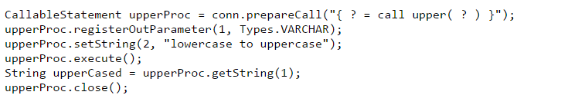
Calling a built in stored function
Upper() function is simply converts the supplied string argument to uppercase
Notes:
Create and prepare-> register->Provide->Call -> Read

Slide 6
Stored Functions Can Return Results in Two Different Ways
From a Function Returning SETOF Type
From a Function Returning a Refcursor

Slide 7
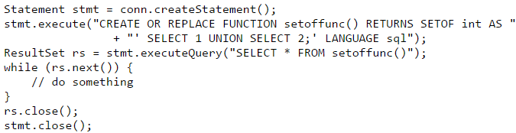
From a Function Returning SETOF Type
Functions that return data as a set should not be called via the CallableStatement interface, but instead should use the normal Statement or PreparedStatement interfaces
When returning SET OF record the output columns are not typed and not named. Thus this form can't be used directly in a FROM clause as if it was a subquery or a table.

Slide 8
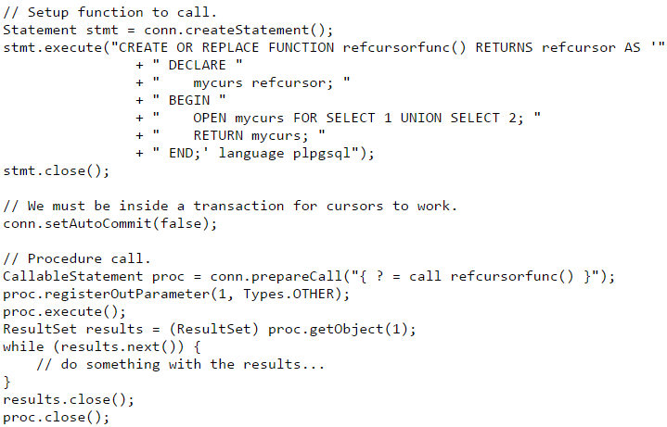
From a Function Returning a Refcursor
When calling a function that returns a refcursor you must cast the return type of getObject to a ResultSet

Slide 9
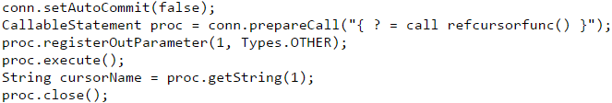
Treating refcursor as a cursor name
It is also possible to treat the refcursor return value as a cursor name directly. To do this, use the getString of ResultSet. With the underlying cursor name, you are free to directly use cursor commands on it, such as FETCH and MOVE.

Slide 10
THE END

